Slide 1

Female Education and Economic Growth
An Open-Ended Capstone Project for Social good

Slide 2
Objective of the study
Examine the relationship between female education indicators and economic growth.
Identify patterns between female literacy rates and GDP per capita.
Apply data science techniques to derive insights for public understanding.

Slide 3
Problem Statement and Data Source
Problem statement :
Female education is often considered a key driver of long-term economic development.
This study explores whether higher female education levels are associated with better economic outcomes.
Data Source :
World Bank Open Data
Country –level education and economic indicators

Slide 4
Research Questions
Is female education associated with higher GDP per capita across countries?
1
Which female education indicators have the strongest impact on economic growth?
2
Can machine learning models predict GDP per capita using education-related features?
3

Slide 5
🛠️ Tools & Technologies Used
Programming & Analysis
Python – used for data cleaning, exploratory data analysis, and model building
Pandas & NumPy – for data manipulation, reshaping, and numerical operations
Visualization
Matplotlib & Seaborn – for visualizing trends and relationships in the data
Machine Learning
Scikit-learn – for building and evaluating regression models
Development Environment
Google Colab – cloud-based environment used for coding, execution, and analysis

Slide 6

Methodology
Data Collection
Data Cleaning & Reshaping
Exploratory Data Analysis (EDA)
Feature Engineering & Data Preparation
Model Building
Model Evaluation
Interpretation & Insights

Slide 7
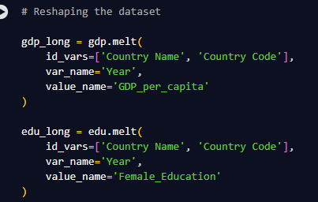
Data Cleaning And
Reshaping
- Removed irrelevant columns such as:
- Indicator Code
- Indicator Name
- Unnamed: 69
- Reshaped both datasets from wide to long format using melt operation
- Converted data types for proper numerical analysis
- Merged education and GDP datasets on common keys (Country & Year)
- Handled missing values to ensure data consistency

Slide 8
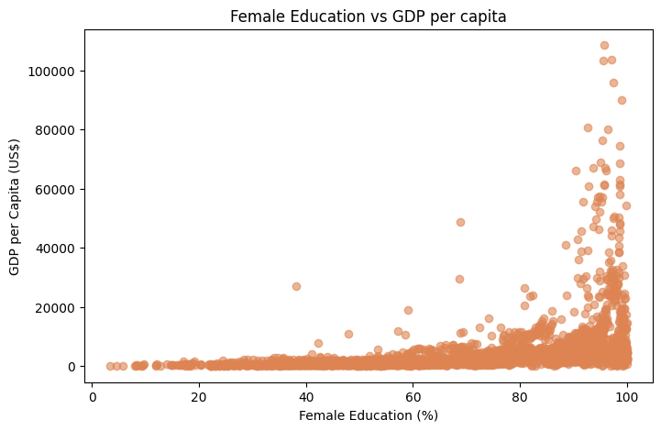
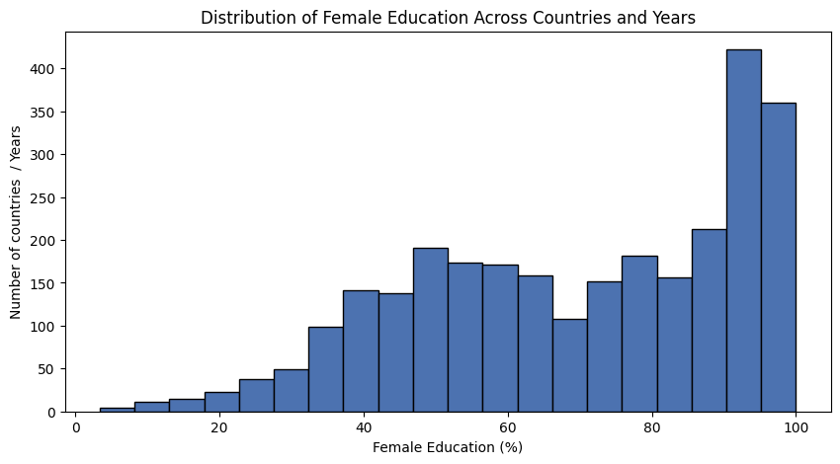
Exploratory Data
Analysis (EDA)
• Female education levels mostly fall in the mid to high range across countries, showing overall improvement over time.
• Countries with lower female education generally have lower GDP per capita.
• Higher GDP per capita is mostly observed where female education levels are higher.
• A moderate positive correlation (0.43) exists between female education and GDP per capita.

Slide 9

Feature Engineering & Data Preparation
Defined target variable and feature set (X and Y)
Split data into training and testing sets
Applied feature scaling using StandardScaler
Prepared dataset for machine learning models

Slide 10




Model Building
Linear Regression
Ridge Regression
• Multiple regression models were trained to predict GDP per capita based on female education indicators.
• Models were chosen to compare linear and non-linear relationships.
• Performance of each model was evaluated to identify the best approach.
Lasso Regression
Random Forest Regressor

Slide 11
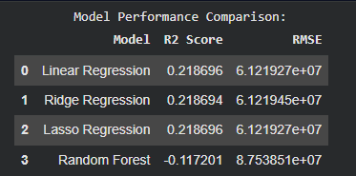

Model Evaluation,
Comparison &
Interpretation
• Multiple regression models were evaluated using R² score and RMSE.
• Linear and Ridge Regression performed better than Random Forest, indicating a mostly linear relationship between education and GDP.
• Linear Regression was selected as the best-performing model based on stable performance and interpretability.
• Interpretation: The positive coefficient (~4044) for female education indicates that an increase in female education is associated with higher GDP per capita.

Slide 12
Key Insights & Business Recommendations
• Female education shows a consistent positive relationship with GDP per capita, highlighting its importance in economic development.
• Countries with higher female education levels tend to achieve better economic outcomes.
• Key Insight:
Education alone does not fully explain economic growth, indicating the influence of additional socio-economic factors.
• Business / Policy Recommendation:
Policymakers should prioritize investment in female education alongside complementary economic and social development programs.

Slide 13
Conclusion
This project explored the relationship between female education and economic growth using global datasets.
Exploratory analysis and regression models revealed a moderate positive association between female education and GDP per capita.
While education plays an important role, economic growth is influenced by multiple additional factors beyond education alone.
The findings emphasize the importance of data-driven analysis in supporting policies aimed at social and economic development.

Slide 14
Thank You

